Slide 1
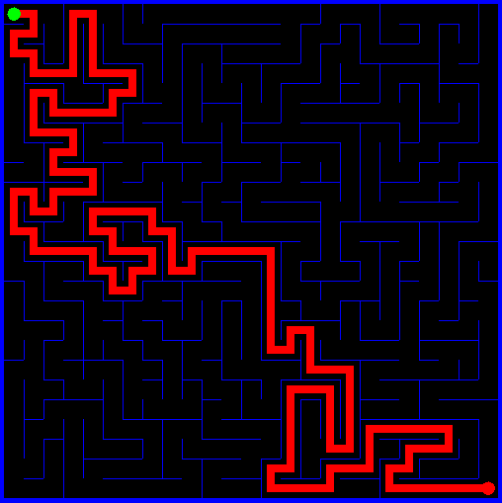
Algorithms and Data Structures
Job Scheduling
Fractional Knapsack
Prim’s
Kruskal’s
Clustering
Huffman Codes
Notes:
Material adapted from Kevin Wayne, Robert Sedgewick and Tim Roughgarden

Slide 2
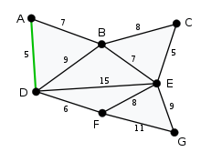
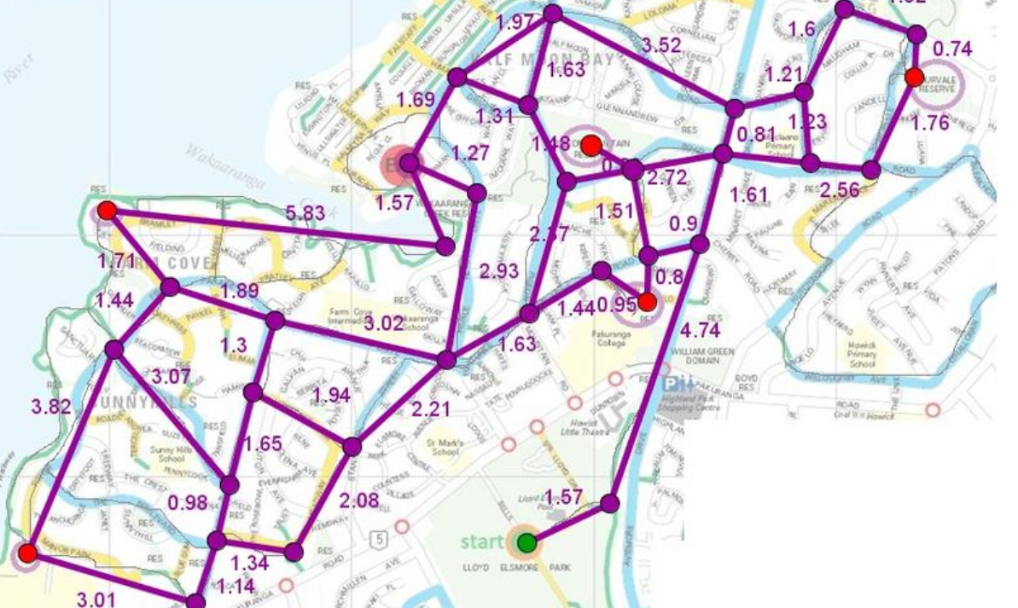
Motivating Reasons
Another tool in your toolbox – easy to implement
Minimum Spanning Trees solve optimally Computer/Transportation/Water Supply Network Problems
Electrical Grids
Data Compression – Huffman Trees

Slide 3
Greedy Algorithms
A greedy algorithm is an algorithmic paradigm that follows the problem solving heuristic of making the locally optimal choice at each stage with the hope of finding a global optimum. In many problems, a greedy strategy does not in general produce an optimal solution, but nonetheless a greedy heuristic may yield locally optimal solutions that approximate a global optimal solution in a reasonable time.
Ex: Dijkstra’s Shortest Path Algorithm, Travelling Salesman
Notes:
From Wikipedia.

Slide 4
Greedy Algorithms
Easy order of growth analysis
Fairly easy to propose multiple greedy algorithms for problems
Hard to establish correctness
Caveat: As previously just stated greedy algorithms are rarely correct despite your intuition.

Slide 5
Making Change
Determine the minimum number of coins to return when giving change in US currency.
Greedy algorithm is optimal b/c
Value of pennies < 5 cents
Value of pennies + nickels < 10 cents
Value of pennies + nickels + dimes < 25 cents
Notes:
Iteratively make myopic decisions by taking the largest denominations each time.

Slide 6
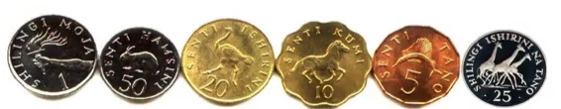
Making Change
In Tanzania, the Greedy algorithm is not optimal!
Notes:
Iteratively make myopic decisions by taking the largest denominations each time.

Slide 7
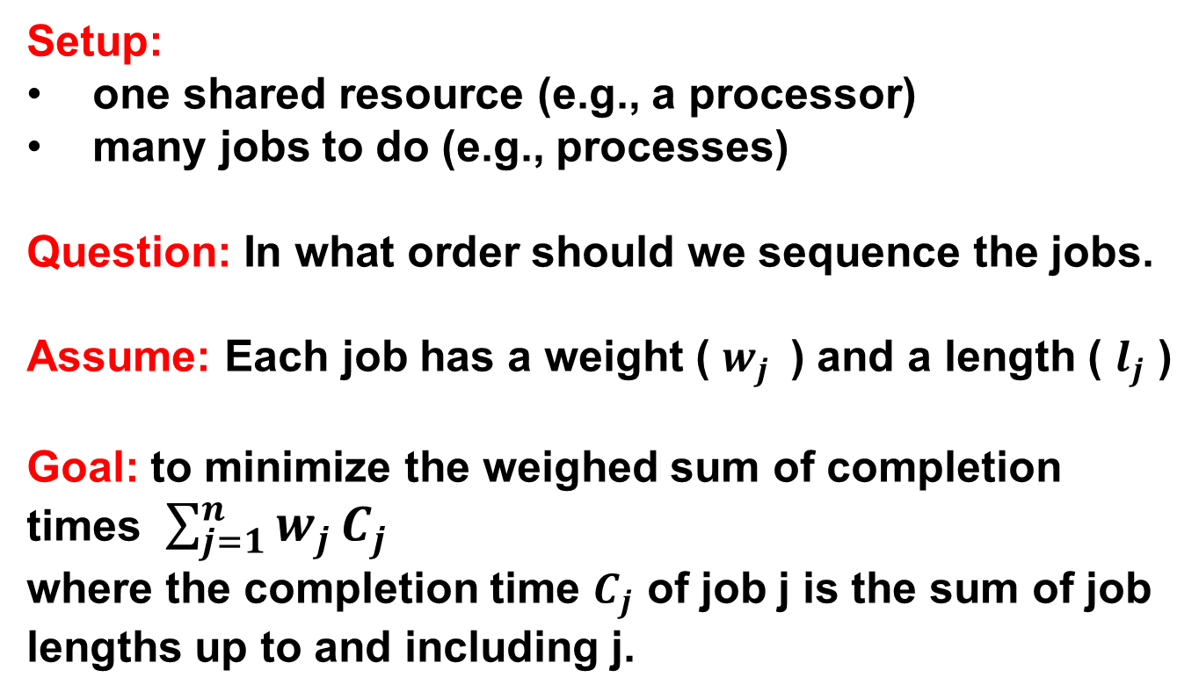
Scheduling Application
Setup:
one shared resource (e.g., a processor)
many jobs to do (e.g., processes)
Question: In what order should we sequence the jobs.
Assume: Each job has a weight ( $w_{j }$ ) and a length ( $l_{j}$ )
Goal: to minimize the weighed sum of completion times $\sum_{j=1}^{n}{w_{j}}C_{j}$
where the completion time $C_{j}$ of job j is the sum of job lengths up to and including j.
Notes:
From Tim Roughgarden

Slide 8
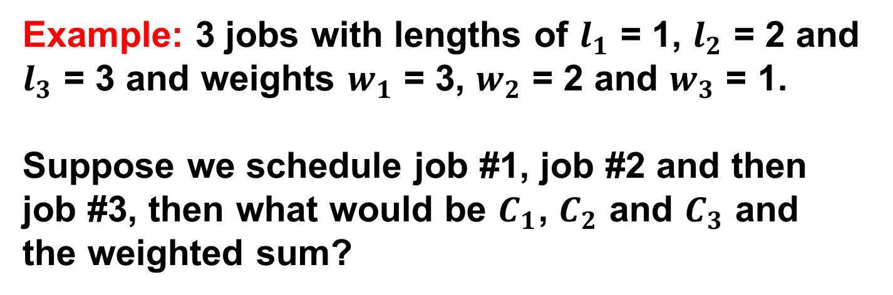
Scheduling Application
Example: 3 jobs with lengths of $l_{1}$ = 1, $l_{2}$ = 2 and $l_{3}$ = 3 and weights $w_{1}$ = 3, $w_{2}$ = 2 and $w_{3}$ = 1.
Suppose we schedule job #1, job #2 and then job #3, then what would be $C_{1}$, $C_{2}$ and $C_{3}$ and the weighted sum?
Notes:
From Tim Roughgarden

Slide 9
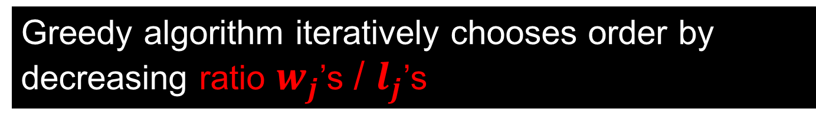
Scheduling Application
Example: 3 jobs with lengths of $l_{1}$ = 1, $l_{2}$ = 2 and $l_{3}$ = 3 and weights $w_{1}$ = 3, $w_{2}$ = 2 and $w_{3}$ = 1.
Suppose we schedule job #1, job #2 and then job #3, then what would be $C_{1}$, $C_{2}$ and $C_{3}$ and the weighted sum?
1, 3 and 6 respectively and 3*1 + 2*3 + 1*6 = 15
Greedy algorithm iteratively chooses order by decreasing ratio $w_{j}$’s / $l_{j}$’s
Notes:
From Tim Roughgarden
Running time is n log n due to sorting.

Slide 10
Fractional Knapsack
Problem: Given weights and values of n items, we need put these items in a knapsack of capacity W to get the maximum total value in the knapsack.
The basic idea of greedy approach is to take highest value/weight ratio and add as much as we can. Repeat with sub-problem.
Notes:
Running time is n log n due to sorting.

Slide 11
Fractional Knapsack
Example: Knapsack capacity = 50lbs
Item 1: $60, 10lbs and ratio 6/1
Item 2: $100, 20lbs and ratio 5/1
Item 3: $120, 30lbs and ratio 4/1
Maximum Value: $240 by taking $60 of first item, $100 of second item and $80 of third item for weights 10, 20, and 20 respectively.

Slide 12
Intervals

Slide 13
Minimum Spanning Trees
Given an undirected weighted graph G = (V,E),
We want to find a subset of E with the minimum total weight that connects all the nodes into a tree – in other words we want to connect a bunch of stuff together as cheap as possible.
Fast Greedy Algorithms:
Primm’s [1957, also Dijkstra 1959, Jarnik 1930]
Kruskal’s [1956]
m log n

Slide 14
Prim’s Algorithm
1
1
0
-1
3
4
5
2
8
3
2
4

Slide 15
Prim’s Algorithm
Main idea:
Maintain a set S that starts out with a single node s
Find the smallest weighted edge e = (u, v) that connects u ∈ S and v ∉ S
Add e to the MST, add v to S
Repeat until S = V

Slide 16
Kruskal’s Algorithm
1
1
0
-1
3
4
5
4
3
8
2
7
2
5

Slide 17
Kruskal’s Algorithm
Pseudocode:
Sort the edges in increasing order of weight
for i = 1 to m
Take the minimum weight edge e
If e connects two disjoint nodes, then connect them (use union-find)
Otherwise, ignore e and try the next edge

Slide 18
Clustering
Assume: We know k:= # of clusters desired. [In practice, can experiment with a range of values]
Call points p & q separated if they're assigned to different clusters.
Problem statement: Given a distance measure d and k, compute the k-clustering with maximum spacing.
Notes:
From Tim RoughGarden

Slide 19
Max-Spacing k-Clusterings
1
4
7
0
3
6
5
9
8
2

Slide 20
Clustering
- Initially, each point in a separate cluster
- Repeat until only k clusters:
- Let p, q = closest pair of separated points (determines the current spacing)
-Merge the clusters containing p & q into a single cluster.
Note: Just like Kruskal's MST algorithm, but stopped early.
-Points are vertices, distances are edge costs, point pairs are edges. Called single-link clustering.
-clustering is one approach to unsupervised learning
Notes:
From Tim RoughGarden

Slide 21
Encoding and Compression of Data
Fax Machines
ASCII
Audio, Video, Images(Lossy)
Variations on ASCII
min number of bits needed
cost of savings
patterns
modifications

Slide 22
Huffman Codes
To encode English text, we need 26 lower case letters, 26 upper case letters, and a handful of punctuation
We can get by with 64 characters (6 bits) in all
Each character is therefore 6 bits wide
We can do better, provided:
Some characters are more frequent than others
Characters may be different bit widths, so that for example, a use only one or two bits, while z uses several
We have a way of decoding the bit stream
Must tell where each character begins and ends

Slide 23
Huffman Codes
Example: Σ = {A, B, C, D} and a fixed length encoding could be {00, 01, 10, 11}.
Suppose we tried a variable length encoding of {0, 01, 10, 1}.
What is 010 an encoding of?
ADA or BA or AC
Solution: Prefix Free Codes – ensure no encodings are a prefix of another one.
Example: {0,10,110,111}

Slide 24
Huffman Codes
Σ | Frequencies | Fixed Length | Variable Length
A | 55% | 00 | 0
B | 30% | 01 | 10
C | 10% | 10 | 110
D | 5% | 11 | 111
Fixed Length: 2 bits per character
Variable Length: .55(1) + .30(2) + .1(3) + .05(3)
= 1.6

Slide 25
Huffman Codes
Goal: To optimize prefix free encoding for a given set of character frequencies.
Idea: binary codes ↔ binary trees
Example:
0
1
A
0
1
B
0
1
C
D

Slide 26
Huffman Codes
Natural Idea is to divide and conquer with a top down approach(Shannon-Fano) but it is suboptimal.
Huffman’s idea was to take a bottom up approach.

Slide 27
Huffman Codes
Σ | Frequencies
A | 55%
B | 30%
C | 10%
D | 5%
A
B
C
D
Meta2 | 45%
Meta | 15%
C
D

Slide 28
Huffman Codes
public class HuffmanNode{
char ch;
int freq;
HuffmanNode left, right;
}
// Must implement Comparable Interface

Slide 29
Huffman Codes
While priority queue contains two or more nodes
Create new node
Dequeue node and make it left subtree
Dequeue next node and make it right subtree
Frequency of new node equals sum of frequency of left and right children
Enqueue new node back into queue

Slide 30
Huffman Codes
1. Scan text to be compressed and tally occurrence of all characters.
2. Sort or prioritize characters based on number of occurrences in text.
3. Build Huffman code tree based on prioritized list.
4. Perform a traversal of tree to determine all code words.
5. Scan text again and create new file using the Huffman codes.

Slide 31
Huffman Codes
Huffman coding is a technique used to compress files for transmission
Uses statistical coding
more frequently used symbols have shorter code words
Works well for text and fax transmissions
An application that uses several data structures and a greedy algorithm to compute optimal prefix free codes

Slide 32

Words of Wisdom
Don’t fall behind.
Visualize and comprehend the problem before writing any code.
Stress test your code thoroughly.
Be patient and take a break
if you’ve been stuck for a while.
Break out the rubber duck.

